Slide 1
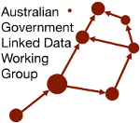
Australian Government Linked Data Working Group (AGLDWG)
Dr Armin Haller
Co-Chair AGLDWG, Senior Lecturer, ANU

Slide 2














AUSTRALIAN GOVERNMENT LINKED DATA WORKING GROUP
Community of Commonwealth Government experts and champions, with invited non-voting participation of individuals, corporations and other entities.
Established in August 2012, with strong growth in membership since the Government released the outcomes of an inquiry on Data Availability and Use in the Australian Government.
No official Government mandate or related legislation, but a community of practice that promotes and represents a series of federal Government entities who seek to implement and use Linked Data technologies for the betterment of Australian Government data sharing.
Several members have signed an MoU to support the use and persistence of linked.data.gov.au URIs.

Slide 3
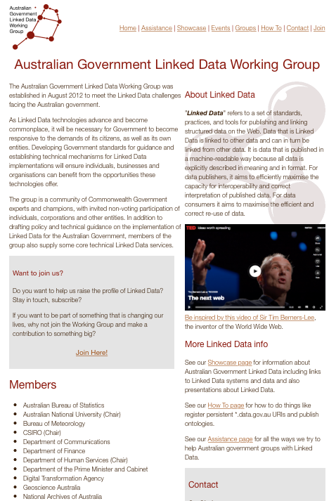
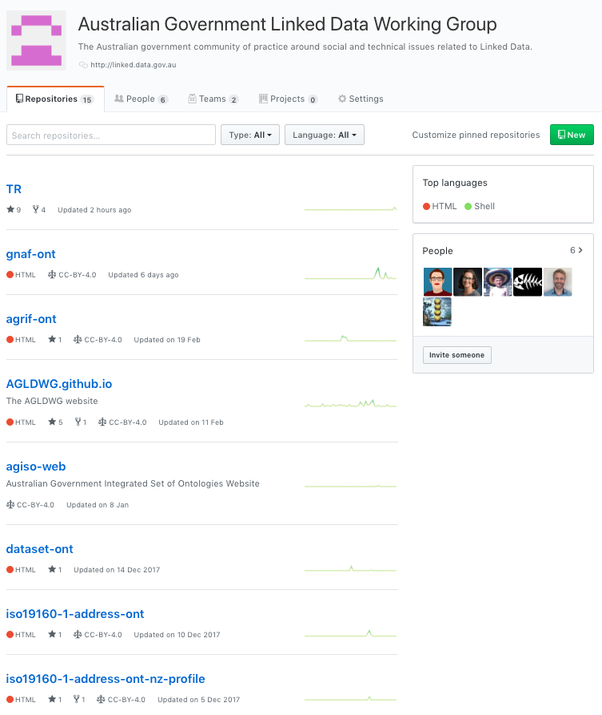
WEB PRESENCE
http://linked.data.gov.au/
https://github.com/AGLDWG

Slide 4
TERMS OF REFERENCE
Establish technical guidance publishing public sector information using Linked Data as a delivery technology
Determine governance rules and processes for the effective management of Australian Government Linked Data
Promote Linked Data across the Australian Government
Engender the development of Linked Data infrastructure

Slide 5
URI GUIDELINES
Top level reserved domain http://{subdomain}.linked.data.gov.au/
{subdomain} includes a set of 25 reserved keywords defined by AGIFT
environment
governance
transport
reference
…
Notes:
emphasis that this is not a single department's namespace and the other roles it plays like catalogue

Slide 6
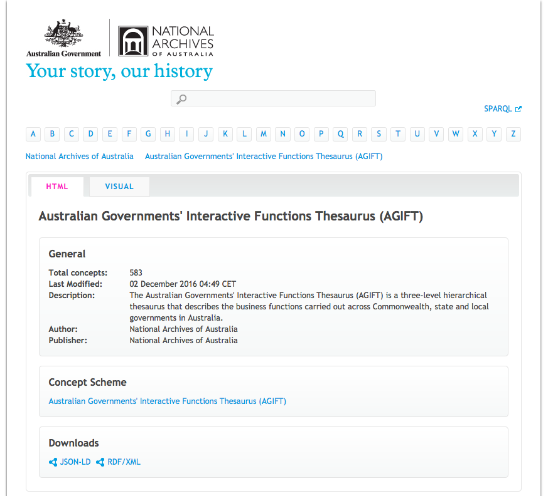
AUSTRALIAN GOVERNMENTS’ INTERACTIVE FUNCTIONS THESAURUS (AGIFT)
Published by National Archives
Three-level hierarchical thesaurus
Describes business functions of Commonwealth, state and local governments in Australia
Contains 25 high-level functions, each with second and third level terms + non-preferred/related terms.
Purpose: To aid online discovery of government information and services
https://data.naa.gov.au/def/agift.html

Slide 7
AGIFT SKOS MODEL
skos:Concept is used to describe the conceptual structure of the thesaurus by asserting that a given resource is a concept
<http://data.gov.au/def/agift/prices-surveillance> a skos:Concept
AGIFT SKOS includes 584 such concepts which are organised into the <http://data.gov.au/def/agift> SKOS concept scheme through the assertion:
agift:prices-surveillance skos:inScheme <http://data.gov.au/def/agift>
25 concepts are top level terms in AGIFT which are referenced from this concept scheme via the skos:hasTopConcept relation
<http://data.gov.au/def/agift> skos:hasTopConcept agift:environment

Slide 8
LINKING AGIFT SKOS TO GLOBAL THESAURI
COFOG, the Classification of the Functions of Government (administered by the UN Statistics Division), classifies government expenditure data by the purpose for which the funds are used.
COFOG includes 10 “functional” groups of expenditures (e.g. Defense, Education and Social Protection), while 2nd-level terms in COFOG are further split into up to 9 sub-groups.
SKOS mappings skos:broadMatch and skos:relatedMatch are used for alignment between SKOS concepts in AGIFT and COFOG, e.g.
<agift:agricultural-industry> skos:relatedMatch <http://unstats.un.org/unsd/cr/references/cofog/version1/04-2-1>

Slide 9
URI GUIDELINES
Set of general guidelines aimed at helping government stakeholders to define and manage URIs for ‘Linked Datasets’ and the resources described within.
Overarching principles:
Use HTTP URIs so that the Linked Dataset URI can be resolved; and
provide at least one machine-readable representation in RDF.
General guidelines on:
Minimum features of a Linked Dataset;
Domain structure of a Linked Dataset;
Recommended URI patterns;
Recommended Publication infrastructure for Linked Datasets;
and URI naming conventions.
https://github.com/AGLDWG/TR/blob/master/guidelines/latest.md

Slide 10
URI GUIDELINES
Index of a Dataset: Identifier that names a Linked dataset and provides metadata of the dataset.
Real-world ‘Things’ Identifier: Physical and abstract ‘Things’ that may be referred to in statements.
Document Identifier: Information on the web about Real World ‘Things’
Vocabulary identifiers (ontologies, concepts etc.): URIs for classes and properties describing real-world things
/dataset[/{module}]*/{datasetid} → /dataset/act/schools [School Dataset Metadata]
/id/{type}/{name} → /id/school/2060 [Canberra Grammar]
/doc/{type}/{name} → /doc/school/2060 [Document about Canberra Grammar]
/def/{scheme}/{concept} → /def/school/phaseOfEducation [Class definition]

Slide 11
AUSTRALIAN GOVERNMENT INTEGRATED SET OF ONTOLOGIES (AGISO)
Working Group is in the process of developing a proposal for an integrated set of ontologies
Currently, there are several ontologies (e.g. Dataset ontology, AGRIF) being developed with a ‘whole of government’ focus
AGISO aims to integrate these ontologies allowing them to be used individually or collectively in a seamless way: as if they were one data model
In making this proposal, the AGLDWG steps beyond international precedent regarding government Linked Data initiatives, in that we intend to provide semantic modelling resources and governance, not just guidelines and recommendations for Linked Data publication

Slide 12
DATASET ONTOLOGY
Designed to describe the characteristics of datasets published on http://data.gov.au/
Contains elements to describe datasets such as:
Publication
Update
Origin
Governance
Spatial and temporal coverage
Aspects of Organisational Custodianship
Governance arrangements

Slide 13
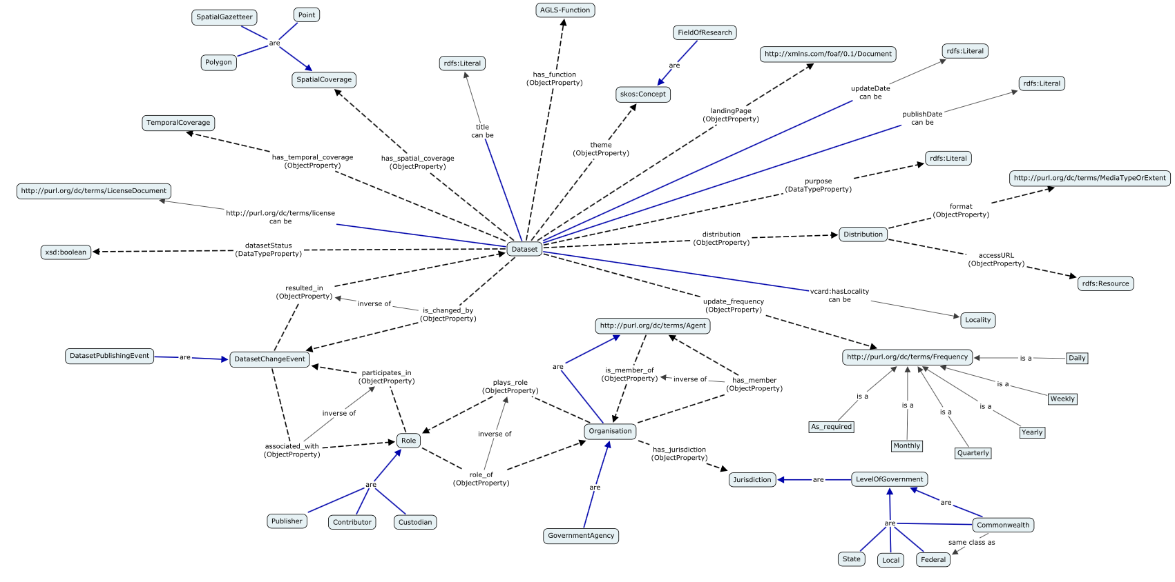
DATASET ONTOLOGY
http://reference.data.gov.au/def/ont/dataset

Slide 14
AUSTRALIAN GOVERNMENT RECORDS INTEROPERABILITY FRAMEWORK (AGRIF)
Ontology to describe the structure, functions, and activities of the Australian Government, providing sufficient context for the effective use of Government information assets.
Contains elements to describe records such as:
Record
Artefact
Event
Policy
Coverage
Role
Agent

Slide 15
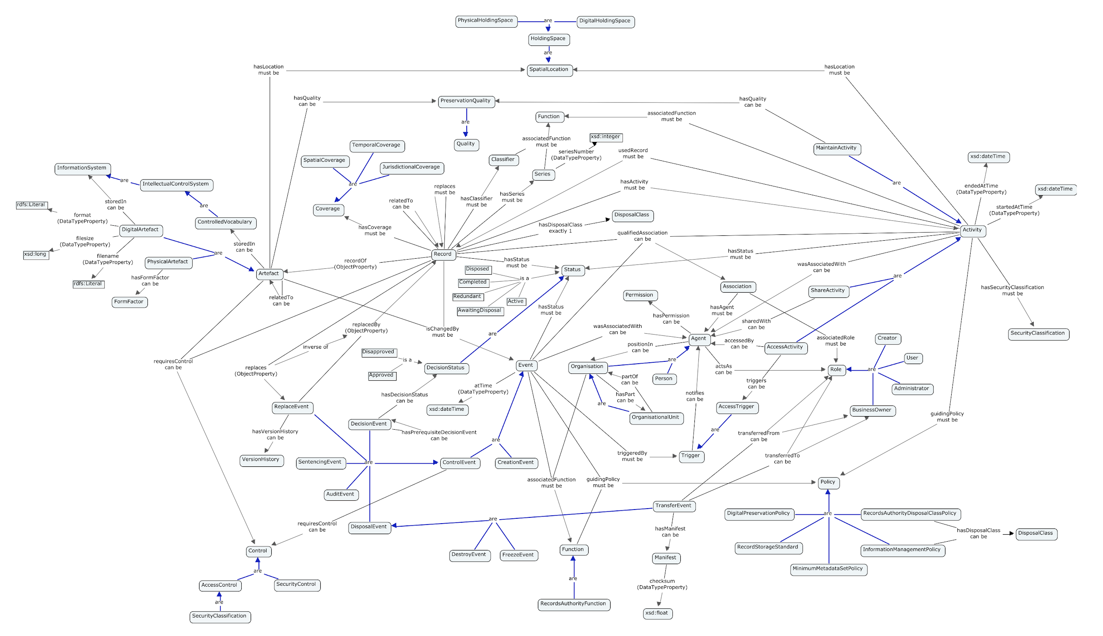
AUSTRALIAN GOVERNMENT RECORDS INTEROPERABILITY FRAMEWORK (AGRIF)
http://pid.data.gov.au/websrv/reference/def/ont/agrif/

Slide 16
EXAMPLE AGLDWG-SUPPORTED LINKED DATA
Geoscience Australia Physical Sample Repository
Bureau of Meteorology long term climate record dataset ACORN-SAT
CSIRO Australian Hydrological Geospatial Fabric (Geofabric)
PSMA Geocoded National Address File (G-NAF)

Slide 17
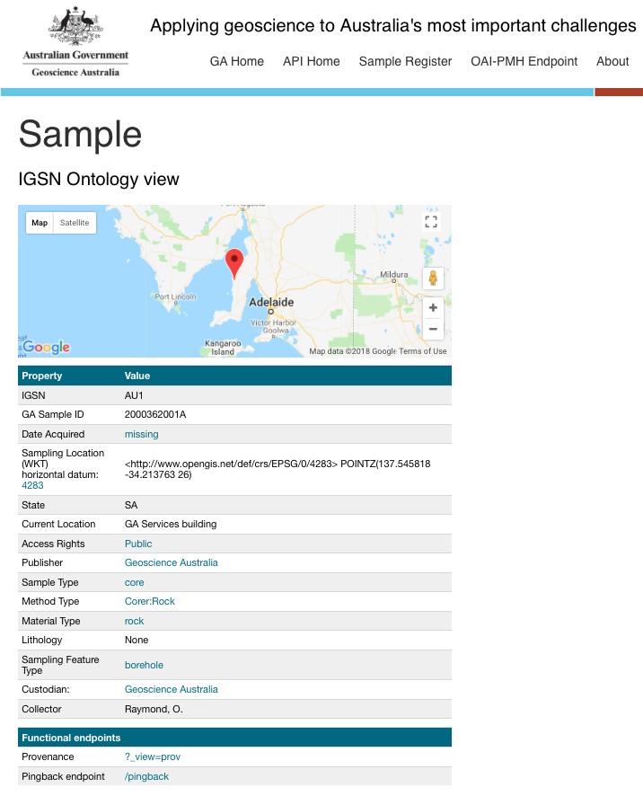
PHYSICAL SAMPLE LOD REPOSITORY
Geoscience Australia's web API delivering metadata for physical samples stored in it's repositories.
Multiple 'views' and 'formats' of samples' metadata is available, including Dublin Core and W3C’s SOSA ontology
http://pid.geoscience.gov.au/sample/

Slide 18
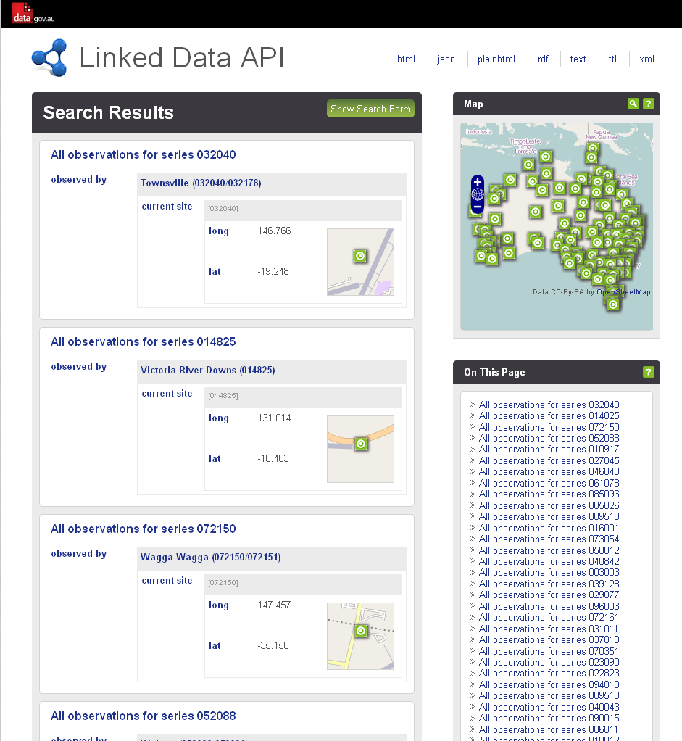
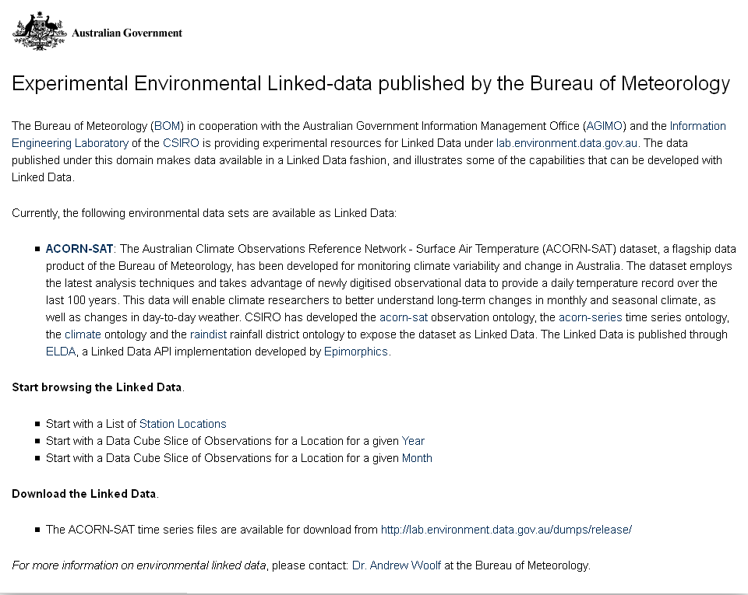
ACORN-SAT LINKED DATA
http://lab.environment.data.gov.au
Notes:
Another example Linked data implementation is from the Bureau of Meteorology. The BoM has published ACORN-SAT a long term climate dataset as Linked Data at the URL lab.environment.data.gov.au. It was the first Linked Dataset by the Australian Government and won some iAwards.

Slide 19
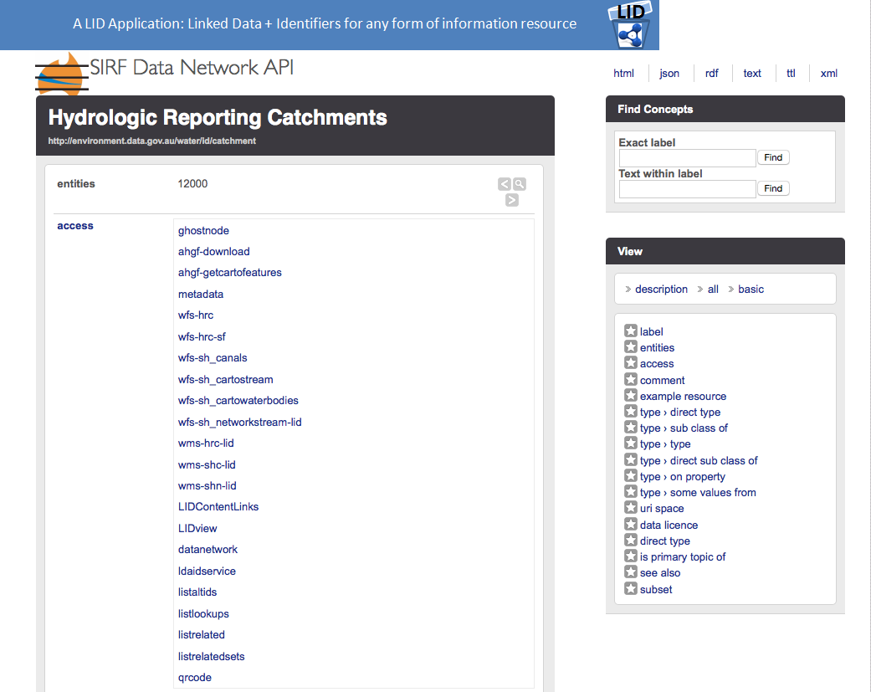
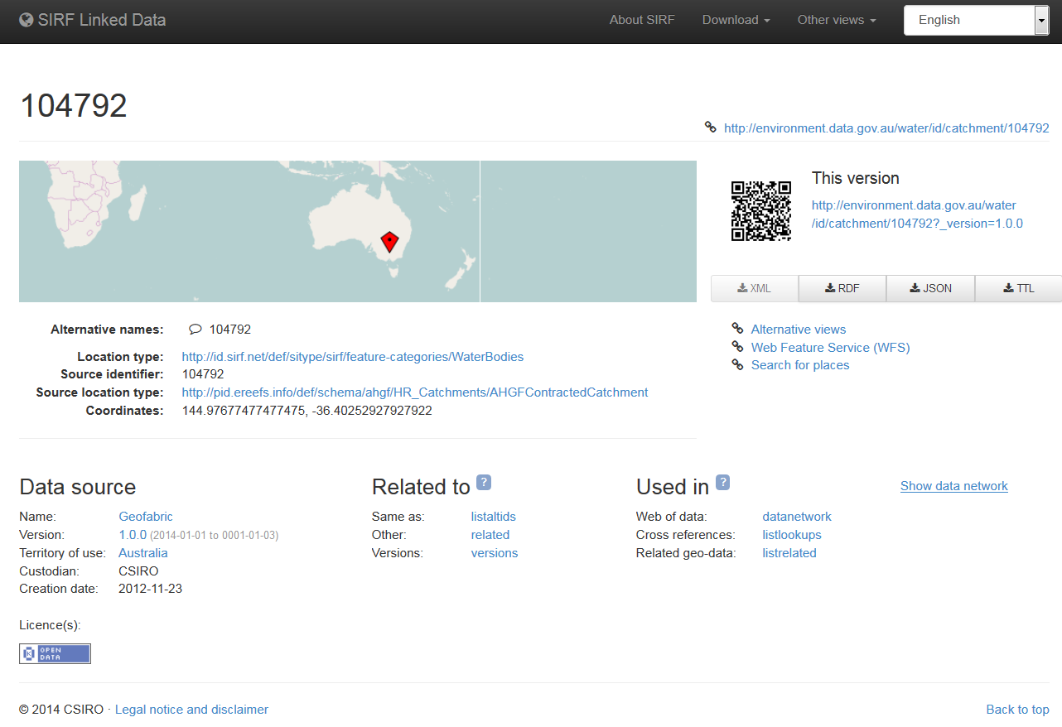
AUSTRALIAN HYDROLOGICAL GEOSPATIAL FABRIC (GEOFABRIC)
http://environment.data.gov.au/water/id/catchment
Notes:
The last example is the Australian Hydrological Geospatial Fabric Linked Data, build by the the BoM and CSIRO which is a set of 6 inter-related data products showing Australia’s rivers and surface water as images, maps and node networks.

Slide 20
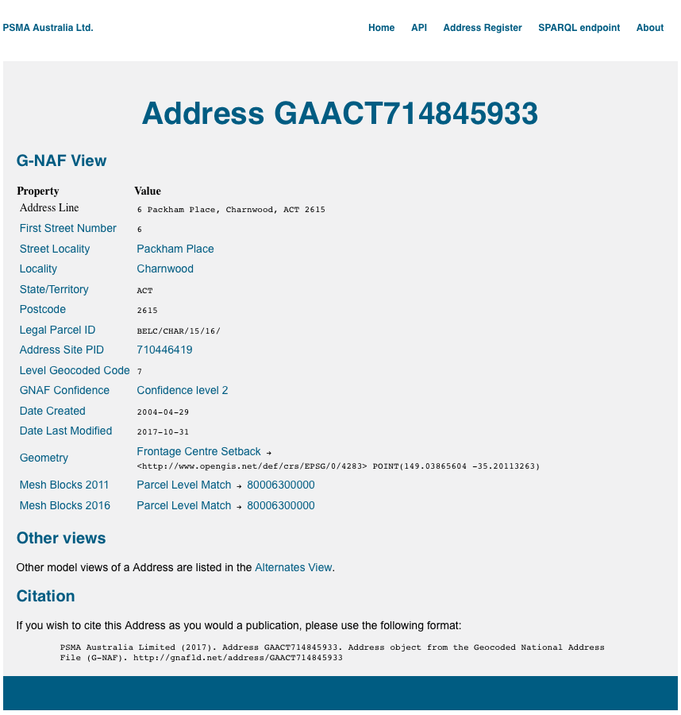
G-NAF - GEOCODED NATIONAL ADDRESS FILE
G-NAF dataset contains all physical addresses in Australia (14.5 million G-NAF addresses)
Built from addresses supplied by 10 contributors including the land agencies in each state and territory of Australia.
http://gnafld.net/address/

Slide 21
QUESTIONS?
http://linked.data.gov.au
https://github.com/AGLDWG

